Slide 1
Deploying an E-commerce Apparel App on EKS

Slide 2
EKS(ELASTIC KUBERNETES SERVICE)
Amazon EKS (Elastic Kubernetes Service) is a service provided by Amazon Web Services (AWS) that makes it easier to run and manage Kubernetes on AWS.
EKS helps by handling the complex setup and management of Kubernetes clusters (groups of computers that run Kubernetes)
Kubernetes is a system that helps you manage and run applications in containers across many computers.
It groups containers together into "pods" (a pod is a small unit where one or more containers run together).
It can automatically increase or decrease the number of containers (or pods) depending on the demand, so your app runs smoothly without manual intervention.
Imagine you're running a website. The website needs different parts like a front-end, back-end, and database. Instead of running all these parts on a single server, Kubernetes can spread them across multiple machines, keep them running, and ensure the website stays up even if something fails.
In short, Kubernetes is a tool that makes it easier to run and manage apps that are split into small parts (containers) across many computers.

Slide 3
What is Microservice
A microservice is a small, independent part of a larger application, each responsible for a specific task. Instead of building one big app, you break it down into smaller services that work together. Each service can be updated, deployed, and scaled on its own.
Imagine you're building an online shopping app:
User Service: This microservice handles everything related to user accounts, like signing up, logging in, and managing profiles.
Product Service: This microservice manages all product details, like adding products, updating prices, and displaying them on the website.
Order Service: This microservice handles creating, processing, and tracking orders when customers buy products.

Slide 4
Deploying an E-commerce Apparel App on EKS
Cloning the Repository:
git clone https://github.com/saisaran63/E-commerce-Website.git
Add the Original Repository as a Remote:
cd eCommerce-Apparel/
git remote add Microservice https://github.com/saisaran63/Microservice.git
Fetch All Branches:
git fetch Microservice
View All Remote Branches:
git branch –a
Create and Push Local Branches to GitHub:
git checkout -b Infra-Steps Microservice/Infra-Steps
git push <our-remote-repo-link>

Slide 5
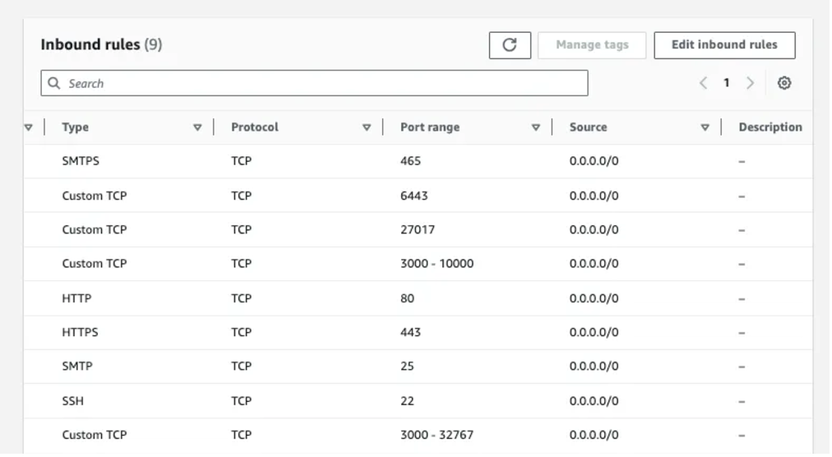
Repeat all above steps for other branches
Setting Up the Environment:
Launch an EC2 instance (Ubuntu, t2.large) and add inbound rules as shown in the
image
Connect the EC2 instance with gitbash/mobaxterm/putty
sudo apt-get update

Slide 6
Create IAM User:
Create a user in AWS IAM with any name and attach the following policies:
AmazonEKS_CNI_Policy
AmazonEKSClusterPolicy
AmazonEC2FullAccess
AmazonEKSWorkerNodePolicy
AWSCloudFormationFullAccess
IAMFullAccess
We have to create an inline policy with the following content:
{
"Version": "2012-10-17",
"Statement": [
{
"Sid": "VisualEditor0",
"Effect": "Allow",
"Action": "eks:*",
"Resource": "*"
}
]
}

Slide 7
Create Security credentials for same user:
Under user → Security Credentials → Access keys → create access key
Install CLI Tools on EC2 Instance:
Create a script (Install_CLIs.sh) to install AWS CLI, kubectl, and eksctl:
Insert the following
Script in install_CLIs.sh
file .
mkdir scripts cd scripts vi install_CLIs.sh
# installing AWSCLI curl "https://awscli.amazonaws.com/awscli-exe-linux-x86_64.zip" -o "awscliv2.zip" sudo apt install unzip unzip awscliv2.zip sudo ./aws/install # installing KUBECTL curl -o kubectl https://amazon-eks.s3.us-west-2.amazonaws.com/1.19.6/2021-01-05/bin/linux/amd64/kubectl chmod +x ./kubectl sudo mv ./kubectl /usr/local/bin kubectl version --short --client # installing EKSCTL curl --silent --location "https://github.com/weaveworks/eksctl/releases/latest/download/eksctl_$(uname -s)_amd64.tar.gz" | tar xz -C /tmp sudo mv /tmp/eksctl /usr/local/bin eksctl version

Slide 8
To install CLI give the below commands:
sudo chmod +x install_CLIs.sh
./install_CLIs.sh
Configure AWS CLI:
Create EKS Cluster:
eksctl create cluster --name=EKS-1 --region=us-east-1 --zones=us-east-1a,us-east-1b --without-nodegroup
Create IAM OIDC Provider:
We associate this with EKS cluster because the service account that we are going to create within the EKS cluster can understand IAM rules
eksctl utils associate-iam-oidc-provider --region us-east-1 --cluster EKS-1 --approve
AWS access key: paste the first access key AWS secret access key: paste the first secret access key Default region name: give region where ec2 instance created Default output format [None]: enter

Slide 9
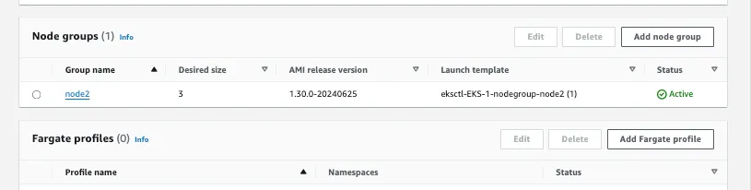
Create Node Group and Enable Auto Scaling:
eksctl create nodegroup --cluster=EKS-1 --region=us-east-1 --name=node2 --node-type=t3.medium --nodes=3 --nodes-min=2 --nodes-max=4 --node-volume-size=20 --ssh-access --ssh-public-key=mahesh-aws --managed --asg-access --external-dns-access --full-ecr-access --appmesh-access --alb-ingress-access
Setting Up Jenkins on EC2 Instance: Install Java and Jenkins
sudo apt install openjdk-17-jre-headless sudo wget -O /usr/share/keyrings/jenkins-keyring.asc https://pkg.jenkins.io/debian-stable/jenkins.io-2023.key echo "deb [signed-by=/usr/share/keyrings/jenkins-keyring.asc] https://pkg.jenkins.io/debian-stable binary/" | sudo tee /etc/apt/sources.list.d/jenkins.list > /dev/null sudo apt-get update sudo apt-get install jenkins -y

Slide 10
Access Jenkins:
Open Jenkins in your browser using <your-ec2-ip>:8080.
Install and Configure Plugins:
Manage Jenkins -> Plugins -> Available Plugins: Install Docker, Docker Pipeline, Kubernetes, Kubernetes CLI, Multibranch Scan Webhook Trigger.
Manage Jenkins -> Tools -> Docker Installations: Add Docker, Name: docker, enable automatic installation.

Slide 11


